Slide 1
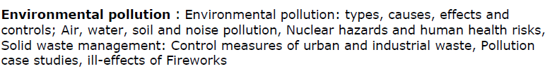
Pollution and Solid Waste

Slide 2
Pollution is the introduction of contaminants into the natural environment that cause adverse change. Pollution can take the form of chemical substances or energy, such as noise, heat or light.
Pollutants, the components of pollution, can be either foreign substances/energies or naturally occurring contaminants.

Slide 3
Land Pollution (Solid Waste Management)

Slide 4
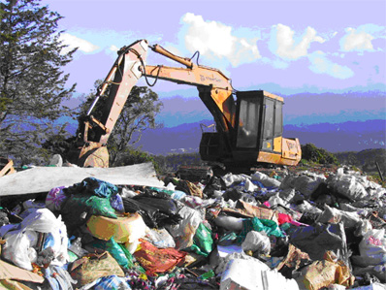
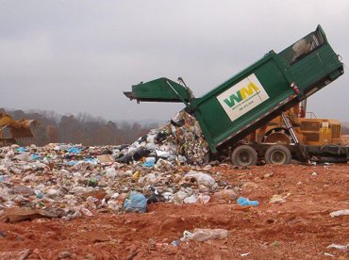
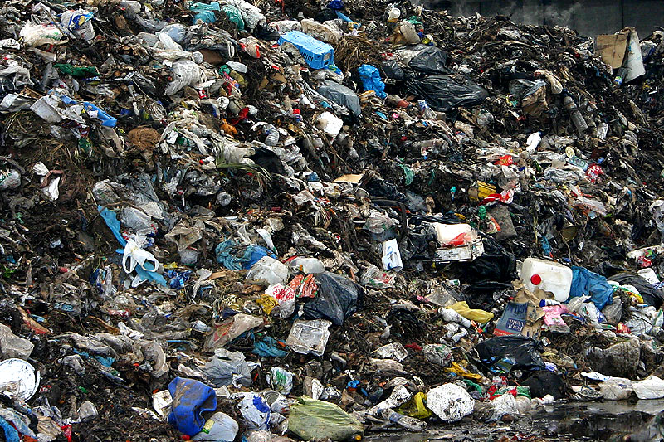
Introduction
Solid waste is that material (such as domestic trash, garbage, metal scrap etc.) which arises from various human activities and which is normally discarded as useless or unwanted. It is responsible for land pollution in urban and industrial areas.

Slide 5
Some common terms
Garbage refers to the putrescible solid waste (Solid waste that contains organic matter capable of being decomposed by microorganisms) constituents produced during the preparation or storage of meat, vegetables, etc.
Rubbish is the non-putrescible solid waste constituents, either combustible or non combustible. Combustible waste includes paper, wood, scrap, rubber, leather, etc. Non-combustible wastes are metals, glass, ceramics etc.
Refuse means all decomposing and non-decomposing combustible and non-combustible solid wastes such as garbage, ashes, paper, cans, wood scraps, plastic etc.

Slide 6
Important source of solid waste
Domestic garbage refers to household wastes such as plastic, paper, glass pieces, metal objects etc.
Pathological wastes include dead animals and human waste.
Industrial wastes generally include chemicals, paints, sand, metal ore processing, fly ash, sewage treatment sludge, etc.
Agricultural wastes contain mainly farm animal manure and crop residues.
Municipal Solid waste (MSW) is commonly known as trash or garbage and consists of everyday items such as product packaging, furniture, bottles etc.
Mining wastes result from mining activities. Eg. Heavy metals.

Slide 7
Important source of solid waste
Radioactive wastes: Nuclear explosions, nuclear testing, use of radioactive substances in medical and scientific research etc.
Hospital wastes includes disposable needles, syringes, blades, tissues etc.
E-waste refers to electrical and electronic equipment wastes.

Slide 8
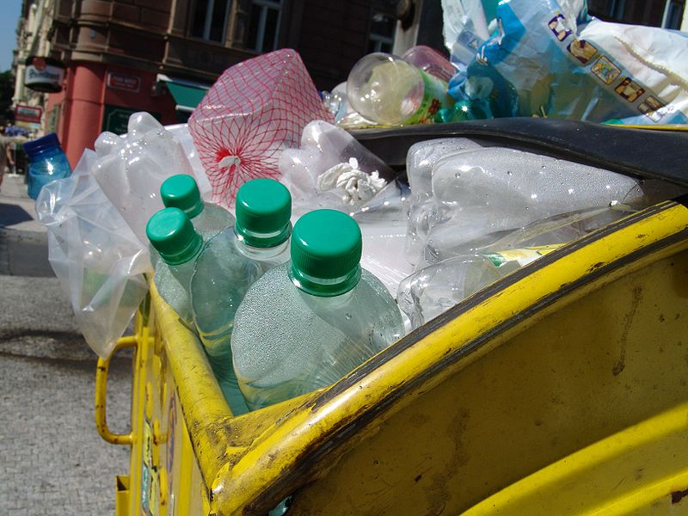
Plastic bottles in a trash can

Slide 9
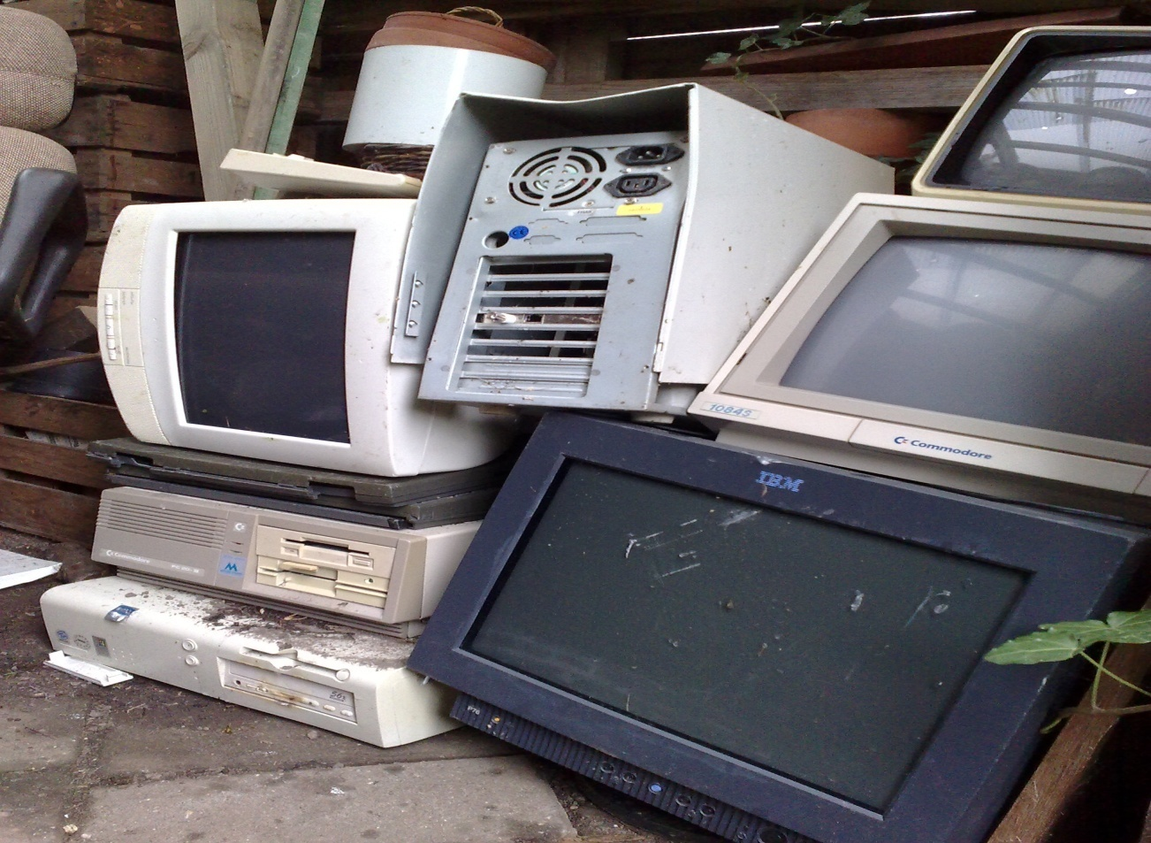
E waste

Slide 10
Effects of Solid Waste
Solid waste helps disease-causing organisms such as mosquitoes, flies, etc., to thrive freely and increase in population.
It runs off with rainwater and mixes with the nearby water bodies causing water pollution.
Burning of solid waste leads to air pollution.
Radioactive substances present in solid waste cause a number of diseases in human beings.
Solid waste reduces the aesthetic value of land.
Non-biodegradable solid wastes such as polythene, plastic, rubber, etc., release toxic gases when burnt hence causing air pollution.

Slide 11
Solid waste management
Indiscriminate disposal of solid wastes-especially of hazardous waste causes adverse environment effects.
The main objective of solid waste management is to minimize these adverse effects before it becomes too difficult to rectify in the future.

Slide 12

Treatment of Solid Waste
Solid waste management (SWM) is a
three-step process:
Collection of solid waste
Transportation of solid waste
Disposal of solid waste

Slide 13
Solid waste management
Waste generation
Collection
Transportation
Disposal

Slide 14
Collection of solid waste
Large number of dustbins must be provided to enable proper collection of solid wastes according to categories.
Door to door collection of domestic garbage, is the most common and popular practice.
Rag pickers contribute to waste management. They segregate recyclable materials from other wastes and hence save the cost and time.

Slide 15
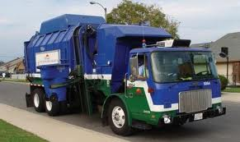
Transportation of solid waste
Transportation of solid wastes from urban areas to the dumping grounds with the help of tractors, trucks etc.

Slide 16
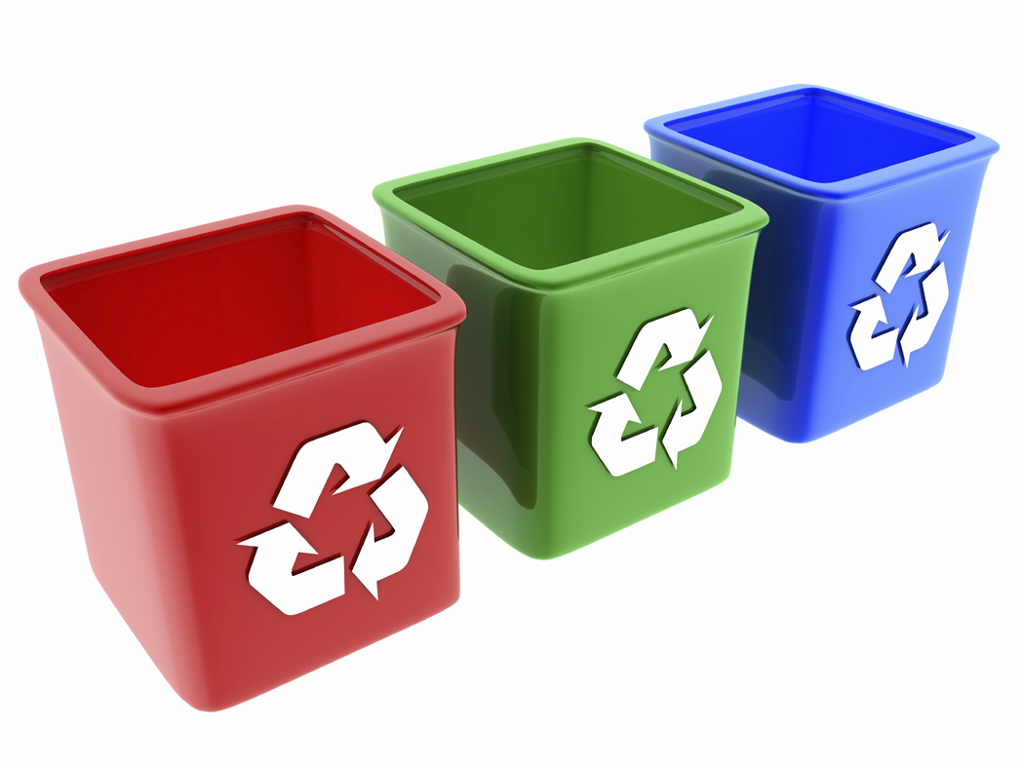
Disposal of solid waste
Open dumping
Land fill
Ocean dumping
Burning
Composting
Reduction at source

Slide 17

5 Rs of Solid Waste Management
Over-consumption and waste of commodities can be checked by adopting the five Rs of consumption.
Refuse
Reduce
Reuse
Repair
Recycle

Slide 18
SOLID WASTE MANAGEMENT
Key to remember!
Main Functional Elements:
Waste generation
Storage
Collection
Transfer/transport
Processing/recovery
Disposal

Slide 19
Solid waste management: Controlmeasures of urban and industrialwaste
https://www.youtube.com/watch?v=Kgjb-b5682I
https://www.youtube.com/watch?v=Qo0K3FfwFgo
https://www.youtube.com/watch?v=yhWnrNQPwAs
https://www.youtube.com/watch?v=dCPMdVDUtR0
https://www.youtube.com/watch?v=SSIRzuE78TA
https://www.youtube.com/watch?v=MFmr6Yapn_A
https://www.youtube.com/watch?v=yhWnrNQPwAs
Pollution case studies:
Oil pollution in the Ecuador Rainforest
https://www.youtube.com/watch?v=l618BhvWkz4
https://www.youtube.com/watch?v=_azgdnGBdh8
Soil and water pollution: DDT and the Bald-eagle population in the US
https://www.youtube.com/watch?v=r--zloLcYys
https://www.youtube.com/watch?v=gnjXsW0AMxs
Mining pollution: tailing dams disaster (Brazil, Italy, Peru)
https://www.youtube.com/watch?v=_l7dKLwI-6c
https://www.youtube.com/watch?v=icZfpfrXGbo
https://www.youtube.com/watch?v=t64XA4qH4jQ
https://www.youtube.com/watch?v=TbI_ZArJ22U
Mining pollution: Odisha (egSukinda)
https://www.youtube.com/watch?v=DcAWQMnkPYg
Water pollution: Singrauli-Sonbhadra region in UP, India and rivers Ganges and Yamuna
https://www.youtube.com/watch?v=XwL46QAnaDg
Ill-effects of Fireworks:
https://www.youtube.com/watch?v=qjvtdxIW0XU
Diwali:
https://www.youtube.com/watch?v=H47bAPEKBRQ
Effect:Air Pollution
https://www.youtube.com/watch?v=3nx5yr2GnGk
https://www.youtube.com/watch?v=WZTYkZgDaEY
Effect: Noise Pollution
https://www.youtube.com/watch?v=tVd-j8Zckhs
Green fireworks:
https://www.youtube.com/watch?v=AI8sjCXQHCE
https://www.youtube.com/watch?v=H47bAPEKBRQ

Slide 20
1. Waste removal system was established in which of the following cities for the first time?
(a) Athens
(b) Lahore
(c) Paris
(d) London
2. Which of the following solid wastes describe the term ‘Municipal Solid Waste’?
(a) Toxic
(b) Hazardous
(c) Non-toxic
(d) Non-hazardous
3. Why it is difficult to recycle plastics?
(a) It is very hard
(b) It comes in different sizes
(c) It is adhesive
(d) It contains different types of polymer resins

Slide 21
1. Waste removal system was established in which of the following cities for the first time?
(a) Athens
(b) Lahore
(c) Paris
(d) London
Sol:(a) Athens.
2. Which of the following solid wastes describe the term ‘Municipal Solid Waste’?
(a) Toxic
(b) Hazardous
(c) Non-toxic
(d) Non-hazardous
Sol:(d) Non-hazardous.
3. Why it is difficult to recycle plastics?
(a) It is very hard
(b) It comes in different sizes
(c) It is adhesive
(d) It contains different types of polymer resins
Sol:(d) It contains different types of polymer resins

Slide 22
4. Which of the following is done on an individual level?
(a) Burning
(b) Disposal
(c) Recycling
(d) Source reduction
5. Why is recycled paper banned for use in food containers?
(a) Because it creates a lot of spaces
(b) Because it creates contamination
(c) Because paper can be used only one time
(d) Because paper is very thick and can’t cover the food containers
6. Which of the following plans are used as a waste management plan?
(a) Plan for reuse
(b) The integrated plan
(c) Plan for recycling
(d) Plan for reducing

Slide 23
4. Which of the following is done on an individual level?
(a) Burning
(b) Disposal
(c) Recycling
(d) Source reduction
5. Why is recycled paper banned for use in food containers?
(a) Because it creates a lot of spaces
(b) Because it creates contamination
(c) Because paper can be used only one time
(d) Because paper is very thick and can’t cover the food containers
6. Which of the following plans are used as a waste management plan?
(a) Plan for reuse
(b) The integrated plan
(c) Plan for recycling
(d) Plan for reducing

Slide 24
7. The organic material of the solid waste will decompose
(a) By the flow of water
(b) By the soil particles
(c) By the action of microorganisms
(d) By oxidation
8. Which of the following wastes are called the Municipal Solid Waste (MSW)?
(a) Food wastes
(b) Wood pieces
(c) Plastic cans
(d) All of the above
9. The process of burning municipal solid wastes under suitable temperature and conditions in a specific furnace is called ______.
(a) Landfill
(b) Incineration
(c) Recycling
(d) Vermicomposting

Slide 25
7. The organic material of the solid waste will decompose
(a) By the flow of water
(b) By the soil particles
(c) By the action of microorganisms
(d) By oxidation
8. Which of the following wastes are called the Municipal Solid Waste (MSW)?
(a) Food wastes
(b) Wood pieces
(c) Plastic cans
(d) All of the above
9. The process of burning municipal solid wastes under suitable temperature and conditions in a specific furnace is called ______.
(a) Landfill
(b) Incineration
(c) Recycling
(d) Vermicomposting

Slide 26
10. The burning of solid waste is not recommended because
(a) It is very costly
(b) It requires a lot of space
(c) It requires modern technologies
(d) It causes several environmental issues
11. When the organic matter present in the sanitary landfill decomposes, it generates
(a) Methane
(b) Nitrogen
(c) Hydrogen
(d) All of the above
12. Which of the following is the oldest and the most common method used to dump the solid wastes?
(a) River
(b) Ocean
(c) Landfill
(d) None of the above
13. The disposable wastes contain
(a) Solids
(b) Slurries
(c) Liquids
(d) All of the above

Slide 27
10. The burning of solid waste is not recommended because
(a) It is very costly
(b) It requires a lot of space
(c) It requires modern technologies
(d) It causes several environmental issues
11. When the organic matter present in the sanitary landfill decomposes, it generates
(a) Methane
(b) Nitrogen
(c) Hydrogen
(d) All of the above
12. Which of the following is the oldest and the most common method used to dump the solid wastes?
(a) River
(b) Ocean
(c) Landfill
(d) None of the above
13. The disposable wastes contain
(a) Solids
(b) Slurries
(c) Liquids
(d) All of the above

Slide 28
14. Find the correct statement
(a) The waste from one process becomes the input for another process
(b) All the processes related to consumption and production produce some kind of waste
(c) There is no real waste in nature
(d) All of the above
15. Which of the following methods is better for the solid waste problem?
(a) Recycling
(b) Landfilling
(c) Both a and b
(d) None of the above
16. Which of the following statements is incorrect for plastic wastes?
(a) It is used to make compost
(b) It lasts for a longer period of time
(c) Toxic fumes are produced when burnt
(d) All of the above
17. Which of the following can be recycled many times?
(a) Wood
(b) Plastic
(c) Aluminium
(d) Organic materials
18. Which of the following gas is produced from landfill wastes?
(a) Biogas
(b) Natural gas
(c) Liquified petroleum gas
(d) All of the above
19. Which of the following statements is true about zero waste management?
(a) Separate collection of each kind of waste
(b) Segregation of garbage at the source
(c) Community involvement
(d) All of the above
20. How many main components are there in integrated waste management?
(a) Two
(b) Three
(c) Seven
(d) Eleven

Slide 29
14. Find the correct statement
(a) The waste from one process becomes the input for another process
(b) All the processes related to consumption and production produce some kind of waste
(c) There is no real waste in nature
(d) All of the above
15. Which of the following methods is better for the solid waste problem?
(a) Recycling
(b) Landfilling
(c) Both a and b
(d) None of the above
16. Which of the following statements is incorrect for plastic wastes?
(a) It is used to make compost
(b) It lasts for a longer period of time
(c) Toxic fumes are produced when burnt
(d) All of the above
17. Which of the following can be recycled many times?
(a) Wood
(b) Plastic
(c) Aluminium
(d) Organic materials
18. Which of the following gas is produced from landfill wastes?
(a) Biogas
(b) Natural gas
(c) Liquified petroleum gas
(d) All of the above
19. Which of the following statements is true about zero waste management?
(a) Separate collection of each kind of waste
(b) Segregation of garbage at the source
(c) Community involvement
(d) All of the above
20. How many main components are there in integrated waste management?
(a) Two
(b) Three
(c) Seven
(d) Eleven

